Slide 1
Strabismus cases 2012 real cases where I have been asked for a written opinion by an optometrist.
Little / no editing Names have been removed
Lionel Kowal RVEEH Melbourne
strabism@netspace.net.au
This talk will be on my website
www.privateeyeclinic.com next week

Slide 2
But first…..some venting
1. ‘It’s only cosmetic’
Making abnormal appearance normal improves self esteem in patients of all ages, improves job prospects, improves dating prospects, normalises school socialisation, kids get invited to more birthday parties, more accurate reaching, better visuo- motor function, improved field, ….so it’s hardly ever ‘only cosmetic’

Slide 3
Highly recommended
Kushner, Postgraduate Medical Jnl 2011

Slide 4
Vent #2 : prescribing prisms
You should always have an explanation / diagnosis before prescribing prism
‘Vertical phoria’ is an inadequate expplanation / diagnosis: WHY does this pt have a vertical phoria?
A symptom that responds well to prism can be due to important pathology

Slide 5
Vent #3 hyperopia & cycloplegic refraction (CR)
With amblyopia &/or esotropia you must do a CR, and repeat the CR if outcomes are imperfect because hyperopia can be a moving target
There is hardly ever ANY justification for prescribing less than the CR
Hyperopia usually decreases in first 1-2 y of life
Hyperopia sometimes increases as children grow esp in high hyperopes
Hyperopia often stable age 4 to 10

Slide 6
Case 1: LA, 1 yr old
Last week I saw a 1 year old girl (DOB 8th July 2010).
Mum had noticed her LE turning in over the last week…. less than 50% of waking hours.
I did not observe any turn during two consults, however Mum showed me a photo which looks like LE esotropia.
The complicating factor is that she was born 10w premature and has cerebral palsy as a result with delayed gross motor coordination.
Cyclo was RE +2.50 / -0.75 x 180 and LE +2.50 / -0.75 x 180.
I could not detect any misalignment of the eyes and the ocular health appeared normal.
I was wondering if I am safe to watch for now or whether I am best to refer this girl on to you.
I was thinking of a 3 month review (or sooner if the turn becomes more frequent), but given the cerebral palsy I’m not sure if I need to tread more carefully.
Summary:
Intermittent ET by history & by photo. No ET seen. Low+. CP.

Slide 7
Case 1 LA, 1yr old #2
Intermittent ET by history & by photo. No ET seen. Low+. CP.
#1:
Ask Mum to carefully diarise the ET.
Every case of ET reported by a Mum where you find nothing could be CYCLIC ESOTROPIA, very under-recognised rather than rare, and usually diagnosed by diary!
This also gives you the opportunity to check her again in a few [3-4] weeks.
#2:
See what happens when you put 6Δ BI in front of either eye whilst you are attracting her attention to something interesting [I use a noisy U-Tube video on my IPhone]. If she stays straight, that’s good. If she goes ET with 6Δ BI, then we know her motor fusion is poor, and in her +2.50 etc OU can probably cause ET, so monitor carefully.
#3:
When to give glasses, or use different anti- accommodative treatment?
Check that each eye accommodates on a near target – if not, your refraction is wrong OR there is something neurologically wrong.

Slide 8
Case 2: 3 yo with ET
I have just seen a very interesting young 3yo girl…
She was referred by her GP as Mum and daycare had noticed esotropia since she was sick 5/52 ago.
She had 3 episodes in one night of nystagmus/staring/not comprehending (lasting 5 minutes) and a slight temperature. Her GP said they were convulsions?
My findings: R constant 15pd esotropia D=N.
Stereo 140sec without my Rx, 100sec with my Rx
Dry ret R +1.75 L +1.50
Eyes straighten immediately with plus.
VA R 6/15 L 6/9 Lea
Booked to return for cycloplegia….
History seems accurate. Family notices eye turns in completely at times.
My question is; is there any chance that this was epilepsy? Should she be seeing you and possibly having further testing prior to me prescribing the plus?
Summary: Small –mod ET straightened with low+. Probable epilepsy.

Slide 9
Case 2: 3 yo #2
Small –mod ET straightened with low+. Probable epilepsy.
Tough one
Treat it for now as an accommodative ET precipitated by being sick.
Cyclo: give full +
If always straight with + and no amblyopia, there is really no need to ever see an ophthalmologist
Stereo is a good prognostic sign
GP to monitor the rest
CNS problems: for you it means reduced chance of it all being straightforward, & needing to refer

Slide 10
Case 3: 6 yo #1
Recent episodes of micropsia
I have a 6yo male patient presenting with intermittent episodes of micropsia over the last three months (X3 weekly, 10-20 min duration).
He has an unremarkable ocular examination.
He has a relevant medical history of anxiety for which he is seeing psychologists.
His mother has a relevant FOH of migraine.
Does he need referral to a paediatric neurologist? or am I safe to make a diagnosis of migraine?

Slide 11
Case 3: 6 yo #2
Recent episodes of micropsia
Intermittent micropsia is hardly ever important
It might be more common in current or future migraineurs, but is it not migraine per se.
I have heard of but never seen a child with this symptom 2ary to temporal lobe epilepsy

Slide 12
Case 3: 6 yo #3
Recent episodes of micropsia
Survey of Ophthalmology Vol 44, Sept-Oct 1999, pp 113-121
Visual Complaints From Healthy Children
It is common for healthy children with specific visual complaints to be seen for eye examinations. After a complete eye examination has ruled out pathologic conditions as the cause of these complaints, it is appropriate for the clinician to explore the possibility that normal entoptic or physiologic visual phenomena might have provoked the child's report of vision problems.
Some of these normal visual experiences are frequent causes of children's complaints of vision problems, such as physiologic diplopia, relaxation of the near synkinesis during reading, and vitreous body floaters.
Some complaints are common, even though the underlying entoptic or physiologic phenomenon may be speculative or obscure, such as the report that objects look bigger or smaller than they actually are.
LK: probably labile accommodation 2ary to anxiety state

Slide 13
Survey of Ophthalmology
Vol 44, Sept-Oct 1999, Pages 113-121
Visual Complaints From Healthy Children
1. Print Blurs With Reading (Scenario 1)
2. Print Blurs With Reading (Scenario 2)
3. With Reading, Words Swim Together (Scenario 1)
4. With Reading, Words Swim Together (Scenario 2)
5. The Chalkboard Blurs
6. I See Double
7. I See Spots
8. There Are Colored Lights in My Vision
9. What I Look at During the Night Disappears
10. Things Seem Brighter With One Eye
11. Things Are Different Colors With Each Eye
12. When I Look at the Sky, I See Things
13. When I Push on My Eye, I See a Purple Light
14. When I Look at Something, Everything Else Disappears
15. Things Look Smaller (or Bigger) Than They Should

Slide 14
Case 4: Dodgy discs #1
I have another Px with slightly dodgy looking discs, could I please get your opinion.
13yo girl, low myope, no neurological symptoms (HA only if sick or sometimes when doing homework).
BCVA 6/5- R+L. Colour vision normal R+L.
Discs look congested, no cup, disc margins look a bit fuzzy but the discs themselves actually look reasonably flat with 90D. I did a 1mo review and the photos look exactly the same as the previous visit.
I'm almost certain that this is just physiological but wanted to double check. Is it ok to just do annual visits now or do I need to monitor more closely?

Slide 15
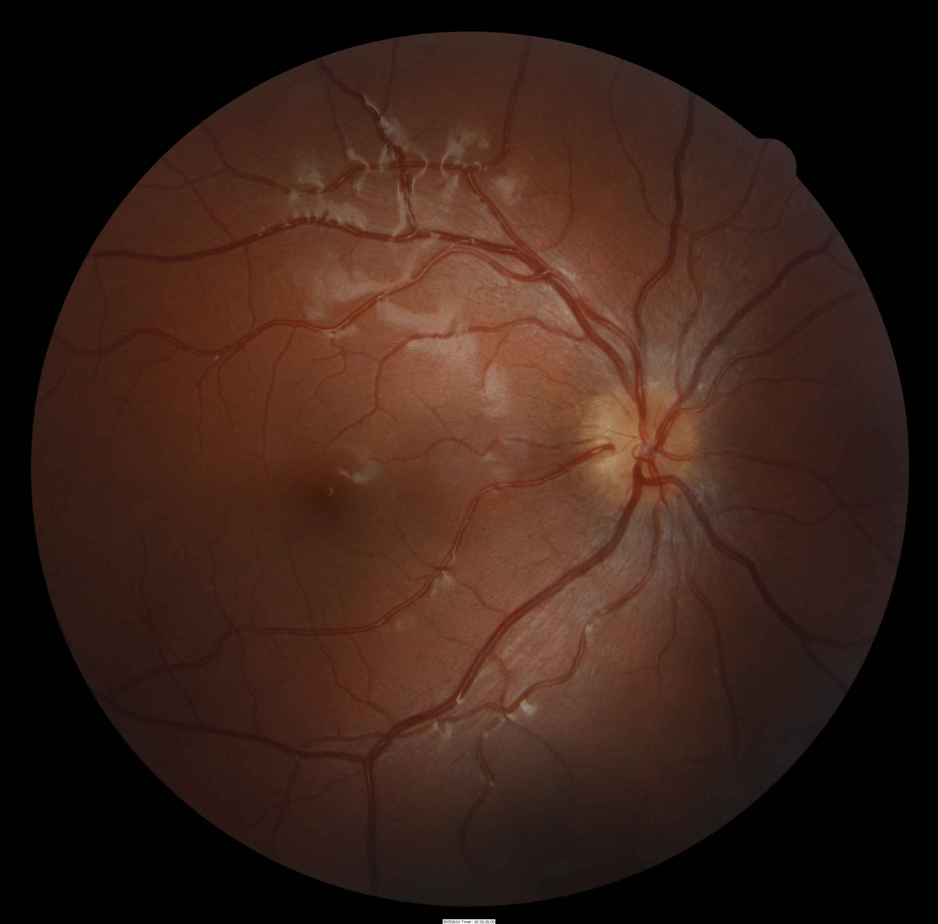
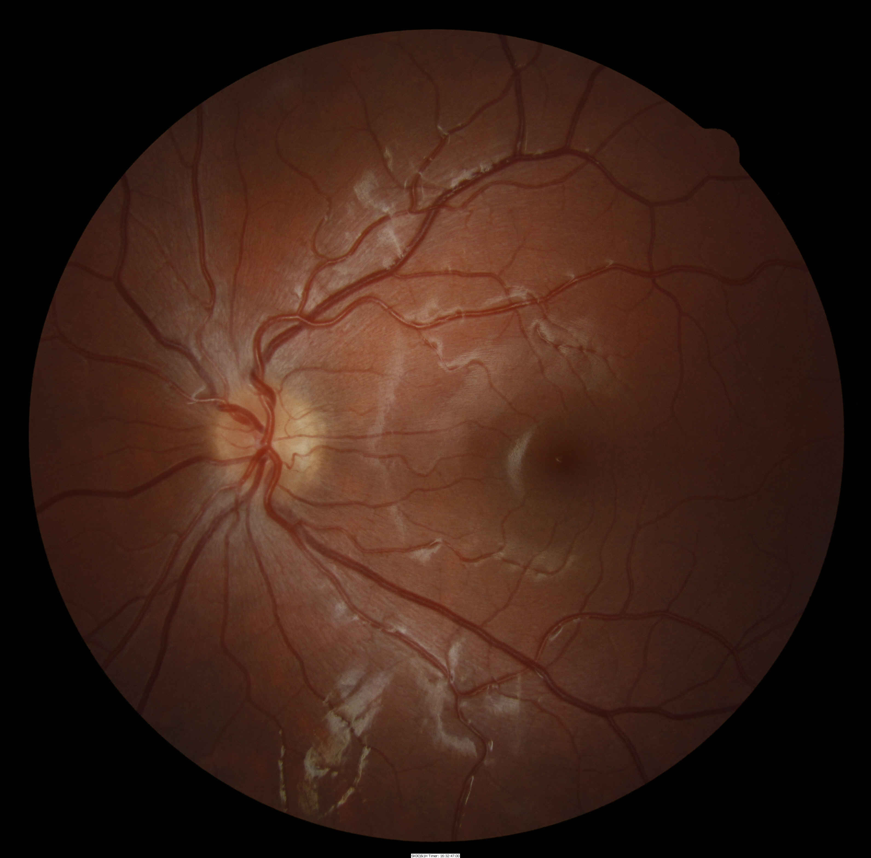
Case 4 : dodgy discs #2

Slide 16
Case 4: dodgy discs #3
These are very difficult cases
Were you able to confidently recognise venous pulsation?
I think a reasonable next test is disc ultrasound &/or disc OCT [ both good for detecting / excluding disc drusen].
Thanks.
SVP maybe in the RE, not in the LE (but I'm not good at detecting SVP except in obvious cases).
I think I'll do OCT and go from there. Thanks again.

Slide 17
Case 4 #4

Slide 18
Case 5 #1
ET in Rosebud infant
…was wondering if i could get your opinion on a young girl I saw this morning in Rosebud. She is 5 mo old and Mum reports her right eye sometimes turns in, ever since she was born. No other concerns. Mum reports a half sister with a turned eye.
She was straight today but appeared to be significantly hyperopic, around +4 to +5, which explains the presumed intermittent esotropia.
I'm wondering whether to put her into glasses straight away and whether to give full plus?
Should I just refer her to see you?
Summary:
Intermittent ET in an infant with moderate +

Slide 19
Case 5 #2
ET in Rosebud infant
Intermittent ET in a 5 mo infant with moderate +
If mum shows you convincing photos of ET in the last few weeks I would give the full + [even an extra +0.50].
If there are no photos, try and see if:
is she ‘nearly ET’ e.g. does 6ΔBI cause ET
Does she accommodate well OU for near?
If she does and you / photos don’t show ET then I’m happy to follow without Rx, but must have regular checkups.
Kids who are ≥+3.50 in one meridian @ 12 mo: 50% develop ET

Slide 20
Case 6 #1
Old lady with headaches & CI
I have a 77 year old female patient who had a right lateral rectus palsy in April 2009. She saw the ED at a local hospital and her blood pressure was 203/100. She had a CT scan at the time.
Her symptoms resolved within a couple of weeks.
She has reported getting headaches since this episode in April 2009. Visual fields were unremarkable.
When I checked her last week, she was ortho at distance and had a 12 L XOT at near.
I have asked her to keep a headache diary, but it is difficult to determine when her headaches are better or worse.
Panadol doesn't seem to help much.
Although she is now being treated for hypertension, just wondering whether there are any other tests you would consider doing for this lady?
Summary: Resolved R 6th. Headaches. Now has CI.

Slide 21
Case 6 #2
Resolved R 6th. Headaches. Now has CI.
All elderly pts with headache need ESR / CRP to rule out temporal arteritis.
Sounds like she had a microvascular 6th in April 2009 with complete recovery.
Now has convergence insufficiency.
It would be interesting to know what her BI reserves were for distance; if poor, she almost has distance ET = divergence insufficiency.
Convergence insufficiency CI + divergence insufficiency DI = ‘vergence insufficiency’ VI.
V.I. more common in Parkinson’s, also seen in the ‘healthy elderly’

Slide 22
Case 7 #1
Partial agenesis corpus callosum & ET
A 5 yo girl has been coming here for the past year. She was very unco-operative early on, though this is gradually improving.
She has a left esotropia, which has become a variably intermittent near ESOT with a low, 1D anisometropic hyperopic -astigmatic script.
Left suppresion is still present.
She has been under extensive genetic investigation and is believed to have an undiagnosed syndrome that also includes mild hearing loss, dysmorphic features (face and ears), microcephaly, short stature and global developtmental delay
MRI (2006): partial agenesis of corpus callosum with non-specific general loss of white matter. No PVL. Secondary thinning of corpus callosum and loss of volume within the pons.
She is making great progress developmentally - according to the mother, she is about a year behind.
In light of this history, I am trying to assess the likely best binocular prognosis. Would you have past cases/ experience, references etc. to help.
Summary: intermittent ET, low+, structural CNS issues

Slide 23
Case 7 #2 intermittent ET, low+, structural CNS issues
ATROPHY OF CORPUS CALLOSUM HAS A LARGE RANGE OF OPHTHALMIC ASSOCIATIONS, AND MANY OF THE PTS ARE OPHTHALMICALLY NORMAL.
THERE ARE 2 GOOD PROGNOSTIC FACTORS:
HAS BEEN SOMETIMES / OFTEN STRAIGHT UNTIL RECENTLY - OUTCOMES ARE BETTER IF STRAIGHTENED WITHIN 2-4 MONTHS OF CONSTANT MISALIGNMENT
REFRACTIVE ERROR MILD – LESS LIKELY TO GET RECURRENT ET
I WOULD BE CAUTIOUSLY OPTIMISTIC ABOUT STABLE ALIGNMENT AFTER SHE IS STRAIGHTENED, AND SHE MAY DEVELOP SOME MOTOR & SENSORY FUSION.
THE CNS PROBLEMS MAKE HIGH QUALITY FUSION LESS LIKELY BUT DO NOT EXCLUDE IT.

Slide 24
Case 8 #1
Anisohyperopic amblyopia with poor treatment compliance
I have an energetic wee man patient; age 5, R +0.25, L +5.00, who has been corrected with glasses and patching over the last 6 mo or so.
He has seen different optometrists and although his Mum comes across very committed the child is hesitant to wear his glasses and avoids his patch. The vision in the left eye is subsequently still hovering around the 6/30 mark.
I have therapeutic endorsement to prescribe atropine, however this would be the first case in which I have felt it might be the best option. I would appreciate your opinion and your recommended protocol for the use of atropine in such a case.
Summary: anisohyperopic amblyopia with poor treatment compliance

Slide 25
Case 8 #2
Anisohyperopic amblyopia with poor treatment compliance
New brooms sweep clean – new Eye Dr, new treatment approach & hopefully new maternal attitude to compliance
I would recommend: start with one drop Atropine Friday night & Saturday night to the R.
Check ~ monthly [=1 cycle].
If L VA not better, increase monthly by one extra consecutive night. So if no response @ 1 month, increase to Friday / Saturday / Sunday nights.
If there is a response, continue with current regime
If ‘best’ result is not 6/12 by the time she has got to daily atropine, talk again about patching.
When you get the best result, taper e.g. continue weekly atropine for a few cycles

Slide 26
Case 9 #1
Hyperopic astigmatism in T21 infant
I’d appreciate you opinion on management of this case.
Katie dob 5/2/2009 (age 9 mo, adopted, Downs syndrome )
Hirschberg shows eyes straight.
Cycloplegic refraction approx +3.0/-2.0x180 Rt and Lt. Media clear. Fundus appears normal.
General health is reported as good. I was advised there is a small hole in heart that is being monitored.
My idea is to monitor again at 18 months and let normal growth and development take its course.
Am I on track or should there be other tests and or treatment?

Slide 27
Case 9 #2
Hyperopic astigmatism in T21 infant
Spherical equiv +2 @ age 9mo is probably ‘normal’.
Astigmatism comes- and- goes @ this age.
The biggest problem with Downs’ is hypo accommodation.
Seeing her next @ age 18mo is sensible.
When you see her next:
check that she accommodates for near. Low threshold for giving +, and low threshold for giving bifocals
look for esodeviation

Slide 28
Case 10 #1
Spontaneous XT and anisohyperopia
I have an 11yo patient who I 1st put in full plus at age 3yo. He is now wearing R +7.50 and L +4.50.
To date he has always, even prior to glasses, been 100% straight.
In the last 4/12 his R eye is starting to diverge D>N. He still has excellent stereo, equal VA's and is aware of diplopia when divergent and can re-fuse quickly.
I tried minus over the Rx today and -1.00 R&L reduces the angle from 10PD to 6PD. This however reduces the BCVA R&L and no doubt won't be as good for reading.
Do you think his risk for greater angle is high?
Should I begin loose prism training and / or reduce plus?

Slide 29
Case 10 #2
Spontaneous XT and anisohyperopia
I would cut the + in the fixing L eye. With your in-office experience that –1 change reduced BCVA, think of doing it in –0.50 steps.
If optical steps don’t work, is probably heading for surgery.
At age 11, wait until he complains a lot himself of poor appearance or troublesome diplopia [it may never happen].

Slide 30
Commenting on others’ problem cases
Good learning exercise for myself, & now AVC
Thank you to all the optometrists who provided cases & didn’t know they were going to be presented

